Slide 1


QGISS
Matthew McKitrick
Master’s Student
GIS Peer Facilitator
Making Great Maps
With

Slide 2
Workshop Outline
Outline
Introduction to Geography, Cartography, and GIS
QGIS Environment
Building a Great Map
I’d rather talk with you than at you, so please ask questions!

Slide 3
Why are you here?

Slide 4
Area of Study
GEOGRAPHY
Definition
The study of the physical features of the earth and its atmosphere, and of human activity as it affects and is affected by these, including the distribution of populations and resources, land use, and industries.
CARTOGRAPHY
GIS
Definition
Geographic Information System. A system for storing and manipulating geographic information on a computer
Definition
The science or practice of drawing maps

Slide 5
First Law of Geography
‘Everything is related to everything else. But near things are more related than distant things.’
Tobler, 1969
Geographers are interested in the the spatial relationships between things
Cartography facilitates the visualization of spatial relationships through mapping

Slide 6


+
METHODOLOGY
TECHNOLOGY
WHAT IS GIS?

Slide 7
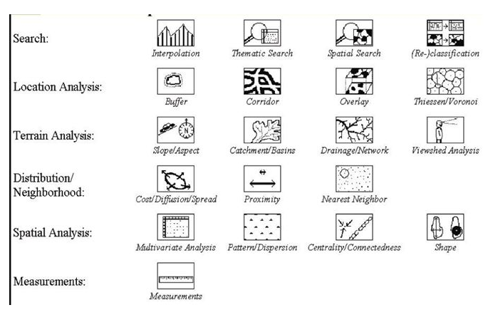
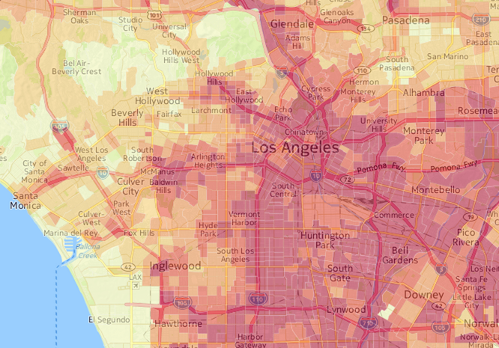
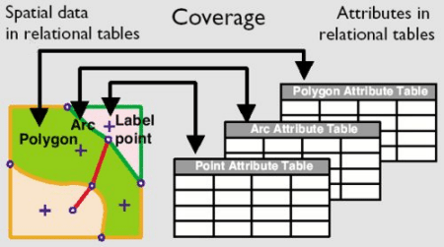

Tools
Data
Visualization
COMPONENTS OF GIS

Slide 8
Longley’s First Law of GIS
‘You get something for nothing by bringing together geographic information from different sources and using it in combination.’
Longley, 2005

Slide 9
First Law of GIS
The derivable information from a combined mosaic of GIS data is greater than the sum of its parts.

Slide 10
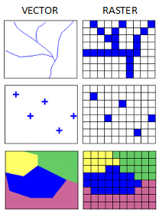
TYPES OF DATA
VECTOR DATA
Discrete shapes with crisp boundaries
Shapes have attributes
Points
Lines
Polygons
RASTER DATA
Continuous surfaces with fuzzy boundaries
Spatial modelling of continuous features
Aerial photography
Satellite imagery
Digital elevation models (DEM)

Slide 11
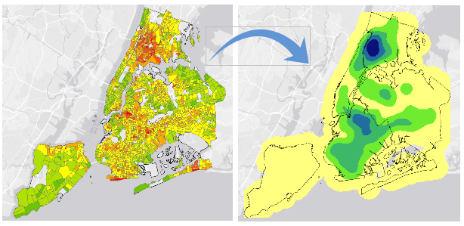
TYPES OF DATA
VECTOR
RASTER

Slide 12
Vector vs Raster
Vector
Imagine drawing points lines or polygons over the proportionate real-world area.
In other words, vector data are spatially reference shapes and points.
Raster
Image a square covered with a grid, each cell of which has an RGB pixel value.
In other words, raster data are spatially referenced images.

Slide 13
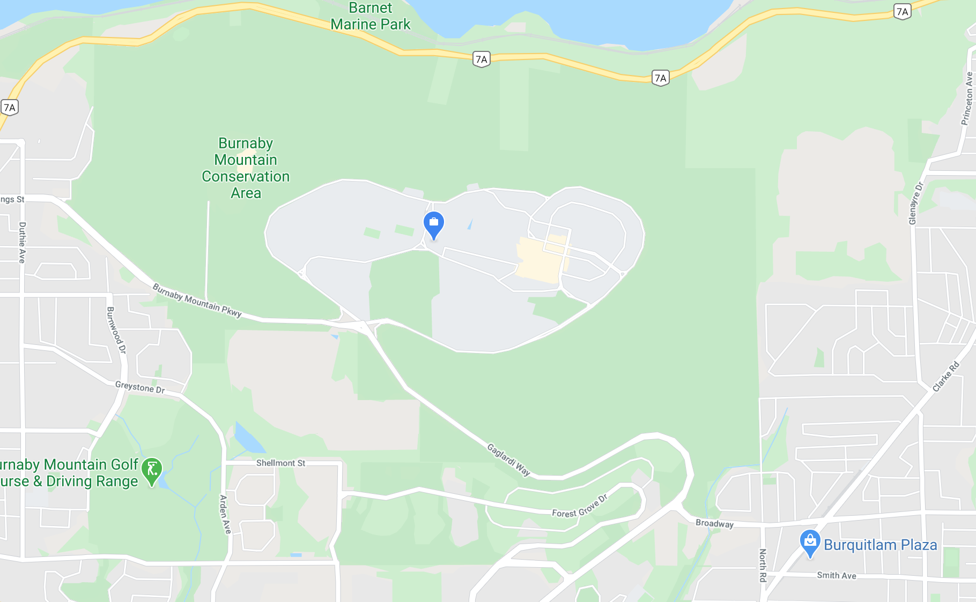
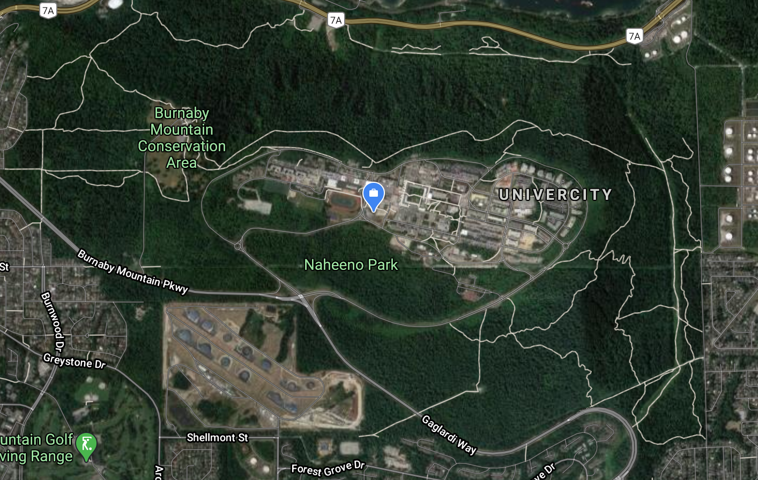
Think Google Maps vs Google Earth
Maps shows us drawn features proportionate to the real world (Vector)
Earth shows us the real ground imagery in a digital format (Raster)

Slide 14
Cartographic Imperatives
Step 1: Establish Target Audience
Who is the map for?
Determines level of Map Interpretability
Step 2: Formulate Map Objective
What is being shown?
What is not being shown?
Step 3: Identify Importance
Why should people read your map?

Slide 15
Cartographic Imperatives Cont.
Who will see the map?
Where will it be seen?
What is its purpose?

Slide 16
Cartographic Aesthetics – External Resource
Layout and Symbolization:
https://www.e-education.psu.edu/maps/l5_p3.html
Choosing Colors:
https://www.e-education.psu.edu/maps/l5_p5.html
Data Classification:
https://www.e-education.psu.edu/maps/l5_p6.html

Slide 17
Area of Study
GEOGRAPHY
Definition
The study of the physical features of the earth and its atmosphere, and of human activity as it affects and is affected by these, including the distribution of populations and resources, land use, and industries.
CARTOGRAPHY
GIS
Definition
Geographic Information System. A system for storing and manipulating geographic information on a computer
Definition
The science or practice of drawing maps

Slide 18
GEOGRAPHY
CARTOGRAPHY
GIS
Analog Data
Paper Maps
Written Records
Cartographic Principles
GPS-Satellite enabled
Geospatial Digital Data
Raster
Vector
Cartographic Design Principles
Geographic Disciplines
DIGITAL CARTOGRAPHY
Aesthetic Focus
GIS Implementation
Spatial Analysis
Physical Drawing Techniques
Computer / Information Science

Slide 19
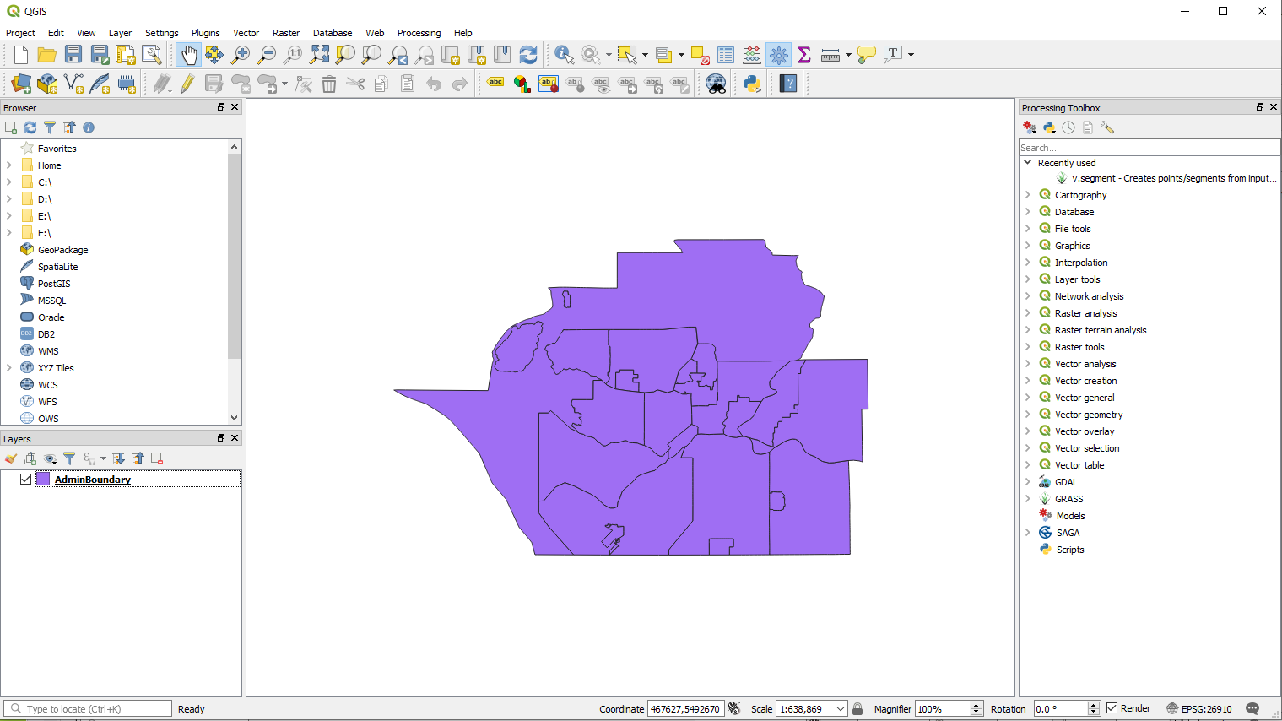
Your Map Area
Where you add data from
Analysis Tools
Your data layers

Slide 20
QGIS
QGIS
Open source
Free
Plugins, plugins, plugins!
Highly interoperable
Great cartography tools
Not quite as many analysis functions as ArcGIS
Windows, Linux, Mac, BSD, Android

Slide 21
Time to Make a Great Map
Preparation
Download data from:
{data link }
Open Instructional Documentation
{Doc link}
Open QGIS
Live Instruction
I will run through the example
Follow along with me and I’ll pause periodically so you can implement the steps
If you get stuck or fall behind, let me know and I can backtrack
There will be time at the end for general questions

